Slide 1
London Housing Case Study Overview
Springboard – July 2021
By Mohamed Ziane

Slide 2
Objective
Using housing data from the official London Datastore government website (up to 2018), determining:
Which boroughs of London has seen the greatest increase in house prices, on average, over the last two decades (from 1998 to 2018)
The workflow used is divided into 4 parts:
Sourcing and Loading
Cleaning, Transforming & Visualizing
Modeling
Evaluating and Concluding

Slide 3
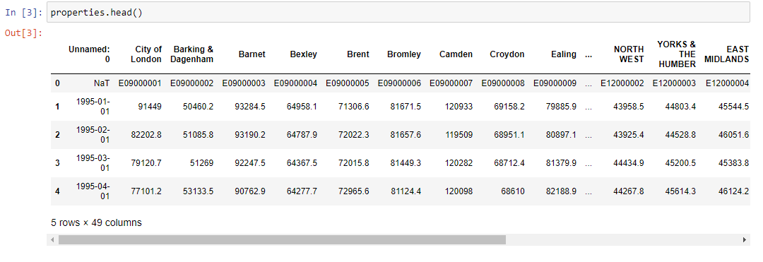
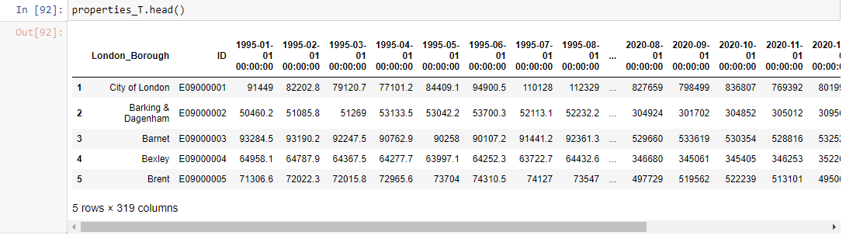
Sourcing and Loading

Slide 4
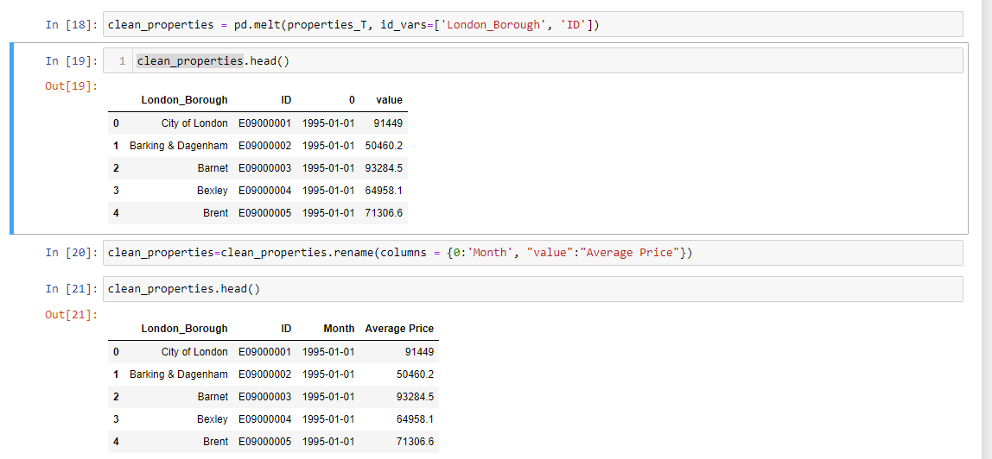
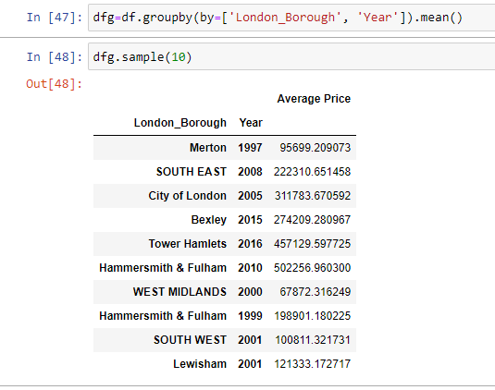
Cleaning, Transforming & Visualizing

Slide 5

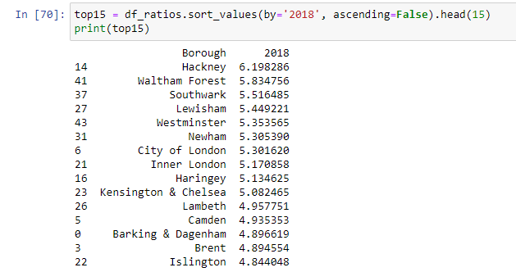
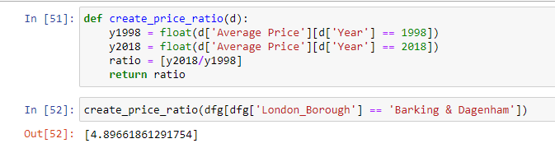
Modeling
Creating a ratio of the average price between 1998 and 2018
Example with the Barking & Dagenham borough (below) and the top 15 ones in descending order (right)

Slide 6
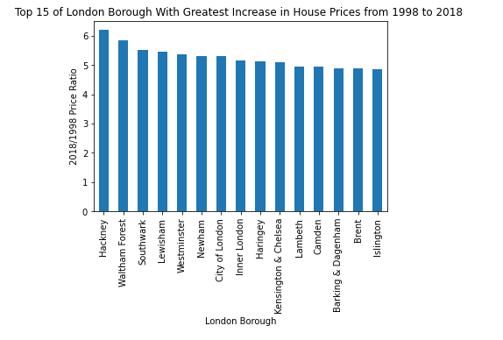
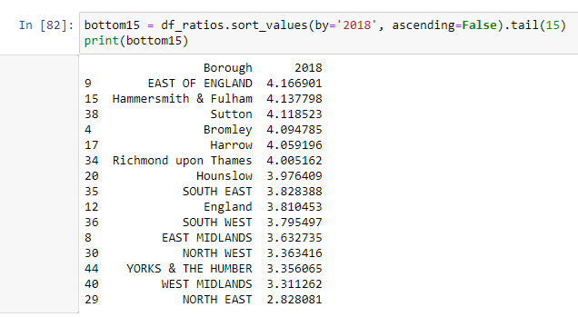
Evaluating and Concluding
The higher the ratio, the higher is the increase from 1998 to 2018.
The top three London Boroughs that had significant increases are Hackney, Waltham Forest and Southwark
The three boroughs that had seen the least increase in prices are North East, West Midlands and Yorks & The Humber

